Slide 1

Trends in Obesity Rates Brian Stogner Stephanie Hucks Andrea Pappa Stacey Poole

Slide 2
Obesity rates have been increasing in the United States.

Slide 3
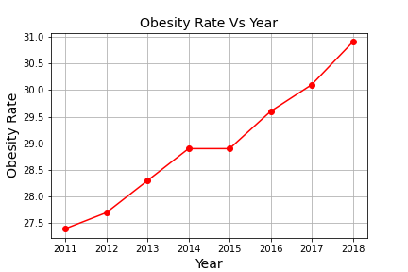
Obesity rates have steadily increased each year.
2011 – 2018

Slide 4
According to
The Center for Disease Control and Prevention (CDC):
Obesity is weight that is higher than what is considered as a healthy weight for a given height
Obesity is a serious health problem and can increase a person’s risk of other diseases and health problems, such as:
Heart disease
Diabetes
High blood pressure
Certain cancers

Slide 5
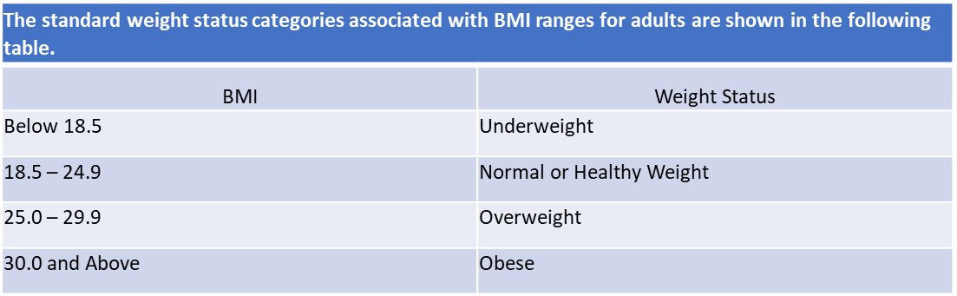
Body Mass Index (BMI)
is used as a screening tool
for determining obesity
BMI is calculated by dividing weight in pounds (lbs) by height in inches (in) squared and multiplying by 703.
Calculation:
[weight (lbs) ÷ (height (in))²] x 703

Slide 6
What is the correlation
of obesity rates to:
Age
1
Gender
2
Education
3
Income
4
Fast Food
5

Slide 7
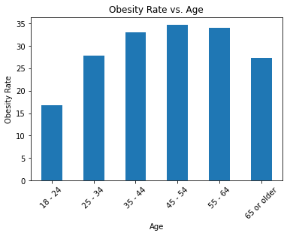
Obesity rates vs. Age
Adults : age 18 – 24 had the lowest obesity rate
Adults: age 45 – 54 had the highest obesity rate

Slide 8
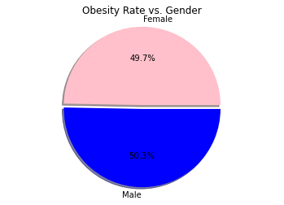
Obesity Rate vs. Gender
There was no significant difference between males and females.

Slide 9
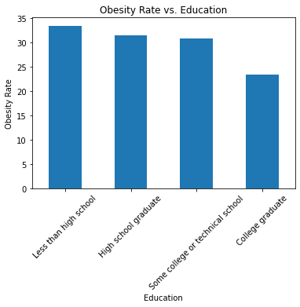
Obesity rates vs. Education
A college level of education showed a lower obesity rate

Slide 10
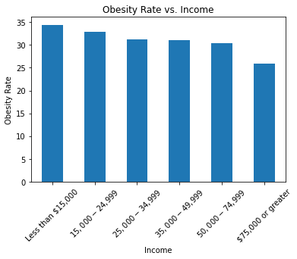
Obesity rates vs. Income
As income increased, obesity rate decreased.

Slide 11
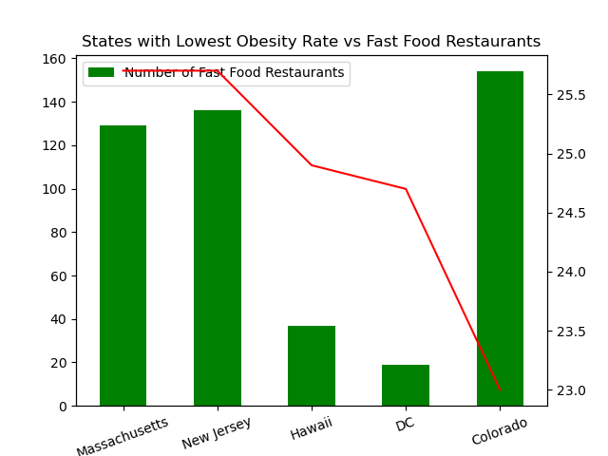
States with
Lowest Obesity Rates vs
Fast Food Restaurants

Slide 12
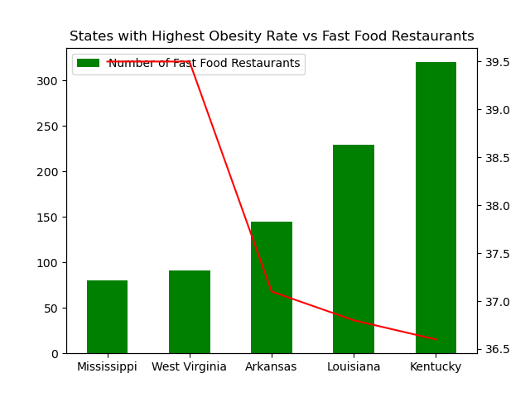
States with
Highest Obesity Rates vs
Fast Food Restaurants

Slide 13
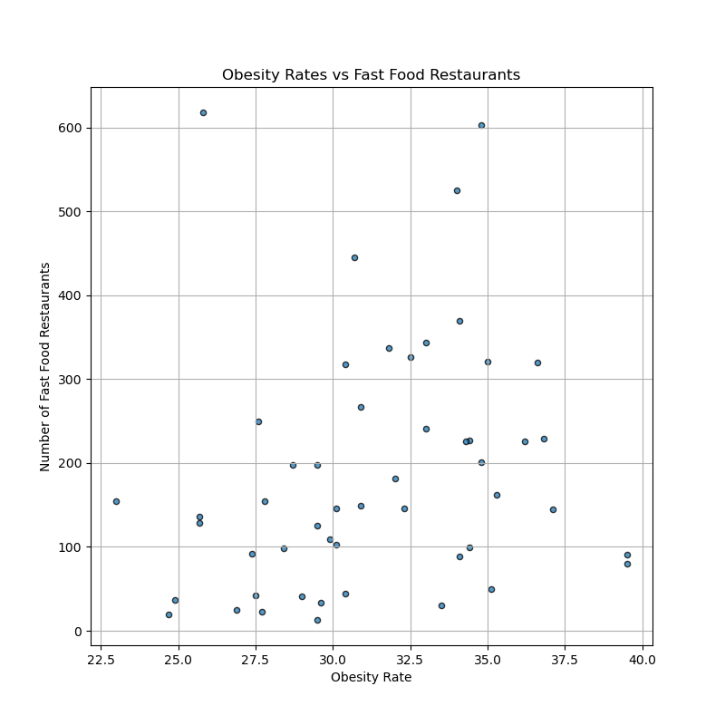
Obesity Rates vs
Fast Food Restaurants
There is no correlation between states with a high number of fast food restaurants and higher obesity rates.

Slide 14
Conclusion:

Slide 15
References:
Repository: https://github.com/atpappa/Project1
https://chronicdata.cdc.gov/Nutrition-Physical-Activity-and-Obesity/Percent-of-adults-aged-18-and-older-who-have-obesi/tv7q-8s5b
https://www.kaggle.com/datafiniti/fast-food-restaurants?select=Datafiniti_Fast_Food_Restaurants_May19.csv
https://www.cdc.gov
https://www.cdc.gov/obesity/data/prevalence-maps.html
Division of Nutrition, Physical Activity, and Obesity, National Center for Chronic Disease Prevention and Health Promotion

Slide 16
# Read CSV pd.set_option('display.max_columns', None) raw_data = pd.read_csv("../Resources/Nutrition__Physical_Activity__and_Obesity_-_Behavioral_Risk_Factor_Surveillance_System.csv") raw_data.head()
year_df = year_data.groupby("YearStart") year_df.mean().head(15)
age_mean_df = age_df.mean()["Data_Value"] age_mean_df
income_mean_df = income_df.mean()["Data_Value"] income_mean_df
Age(years)
18 - 24 16.801402
25 - 34 27.866121
35 - 44 32.976168
45 - 54 34.685981
55 - 64 34.018458
65 or older 27.246262
Name: Data_Value, dtype: float64
Income
$15,000 - $24,999 32.871963
$25,000 - $34,999 31.136682
$35,000 - $49,999 30.976636
$50,000 - $74,999 30.314953
$75,000 or greater 25.968692
Data not reported 24.901869
Less than $15,000 34.405607
Name: Data_Value, dtype: float64
Data_Value
YearStart
2011 | 27.736411
2012 | 27.996622
2013 | 28.815848
2014 | 29.336158
2015 | 29.532550
2016 | 30.085817
2017 | 30.955904
2018 | 31.632798

Slide 17
top_states = pd.DataFrame(fast_food_data['state'].value_counts(ascending=False).head(10).reset_index()) top_states.columns = ['State', 'Number of Fast Food Restaurants'] top_states
education_index = education_mean_df.reindex(['Less than high school','High school graduate', 'Some college or technical school', 'College graduate']) education_index
Education
Less than high school 33.466822
High school graduate 31.516589
Some college or technical school 30.799065
College graduate 23.408645
Name: Data_Value, dtype: float64
 | State | Number of Fast Food Restaurants
0 | CA | 618
1 | TX | 603
2 | OH | 525
3 | FL | 445
4 | IN | 369
5 | NC | 344
6 | IL | 337
7 | GA | 326
8 | MO | 321
9 | KY | 320

